Slide 1
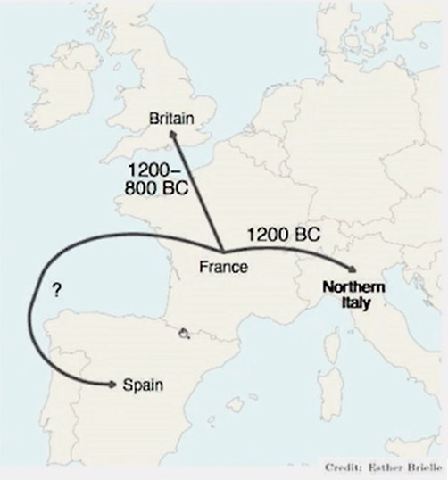
Linguistic Contributions to a Model for the Celticisation of the Western Archipelago
Kathleen Hughes Lecture
Cambridge University
8th May 2025
Prof David Stifter
Department of Early Irish
Maynooth University

Slide 2
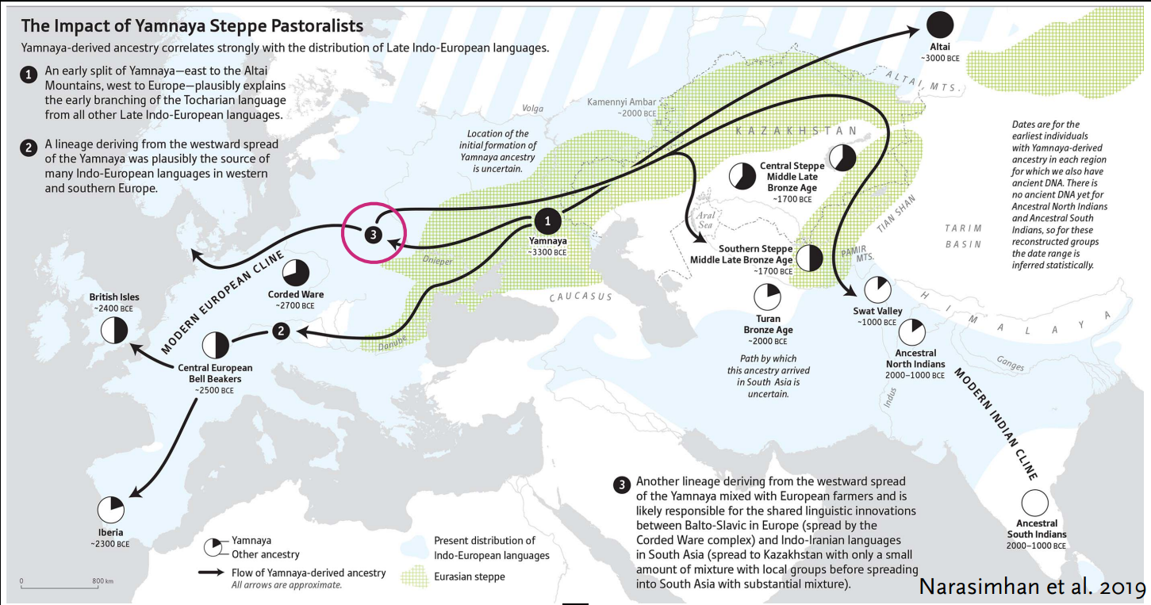
The spread of Indo-European and the Celticisation of the west
Illustration:
Narashiman et al. 2019
Proposed dates:
Early Bronze Age (3rd - 4th mill. BC) e.g., Cunliffe & Koch 2010
Late Bronze Age (1200 - 800 BC) e.g., Drews 2022
Early Iron Age (1st mill. BC) e.g., Sims-Williams 2020
1st cent. AD (Ireland) e.g., Schrijver 2015
?

Slide 3
Towards models of language spread
Linguistics
Archaeology
Genetics

Slide 4
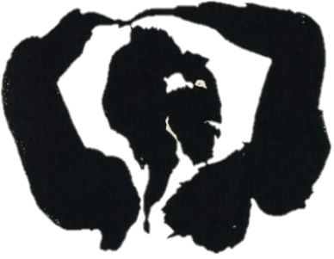
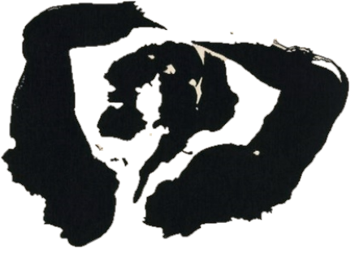
Models of language spread
Linguistics
Archaeology
Uneasy bedfellows
The Táin. Pillow talk, Louis le Brocquy (1969)

Slide 5
Towards models of language spread
Linguistics
Archaeology
Genetics
Genetic data:
aDNA data in Indo-European linguistics since 2015
supports (verifies) or disproves (falsifies) previous hypotheses

Slide 6
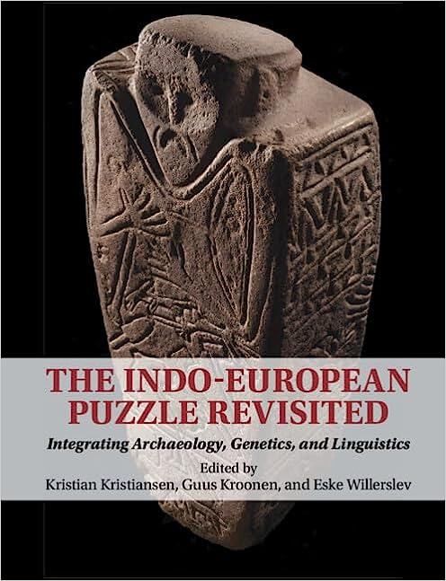
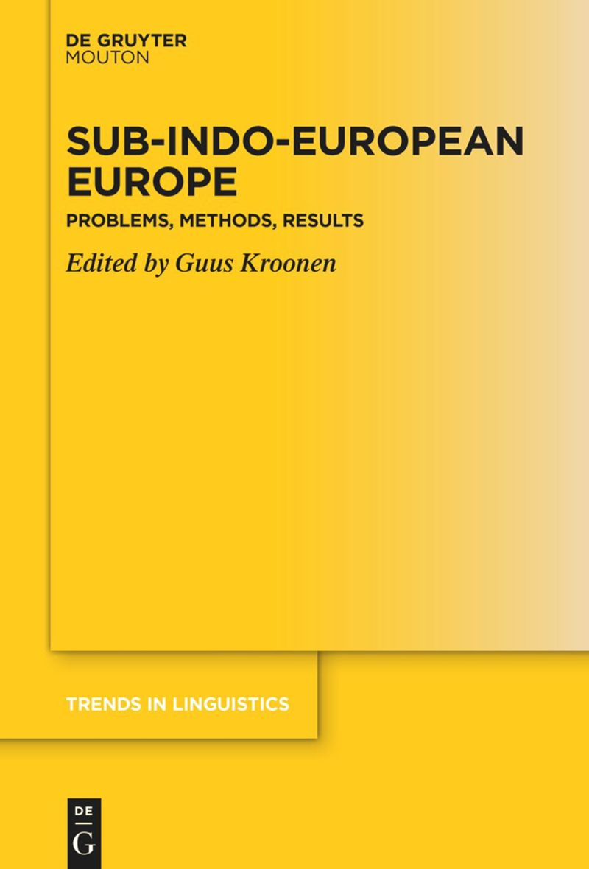
My previous publications on Celtic prehistory
With G. Kroonen’s EUROLITHIC project (ERC StG, Leiden 2017-22):
2023 (views of 2018): ‘With the back to the ocean. The Celtic maritime vocabulary’, in: K. Kristian-sen, G. Kroonen, E. Willerslev (eds.), The Indo-European Puzzle Revisited. Integrating Archaeo-logy, Genetics, and Linguistics, Cambridge University Press 2023, 172–192.
2024 (views of 2021): ‘Prehistoric layers of loanwords in Old Irish’, in: G. Kroonen (ed.), Sub-Indo-European Europe. Problems, Methods, Results, Mouton De Gruyter 2024, 157-202.
Other publications with substratal content:
2010: ‘The invisible third. The Basque and Celtic words for ‘swallow’’, Ériu 60, 145–157.
2019: ‘Further to Avidic: ‘Geese’ in Insular Celtic’, Historische Sprachforschung 132, 312‒316.
2021: ‘The etymology of Breton gad ‘hare’’, Études Celtiques 47, 171‒177.
2024: ‘The rise of gemination in Celtic’, Open Research Europe. Linguistic Diversity collection.
URL: https://open-research-europe.ec.europa.eu/articles/3-24

Slide 7
Progress
My previous talks about the subject:
2022: ‘The Celticisation of the Western Archipelago’ (The Secondary Homelands of the Indo-European Languages. Arbeitstagung der Indogermanischen Gesellschaft, Universiteit Leiden, 5–7 Sept. 2022).
2023: ‘Linguistic Factors in the Celticisation of the Western Archipelago and the Gaelicisation of Ireland’ (29th Euro-pean Association of Archaeologists Annual Meeting. Session 531: Migration and Archaeology after the 3rd Scientific Revolution: aDNA, Isotopes and New Theoretical Perspectives, Queen’s University Belfast, 30 Aug.–2 Sept. 2023).
2024: with Lara Cassidy, ‘The genetic and linguistic prehistory of Ireland’ (Spring Seminar Series, School of Celtic Stu-dies, Dublin Institute of Advanced Studies, 28 March 2024).
Palaeogenetic publications 2025:
Cassidy, Lara, Dan Bradley et al. 2025. ‘Continental influx and pervasive matrilocality in Iron Age Britain’, Nature 15 Jan. 2025. doi: https://doi.org/10.1038/s41586-024-08409-6
McColl, Hugh, Eske Willerslev, Guus Kroonen et al. 2025. ‘Tracing the Spread of Celtic Languages using Ancient Genomics’, bioRxiv prepint 1 March 2025. doi: https://doi.org/10.1101/2025.02.28.640770

Slide 8
Towards models of language spread
Linguistics
Archaeology
Genetics
Genetic data:
better proxy for language spread
Any theory about prehistoric lan-guage distribution is intrinsically speculation.
Speculation is intrinsically part of the solution.

Slide 9
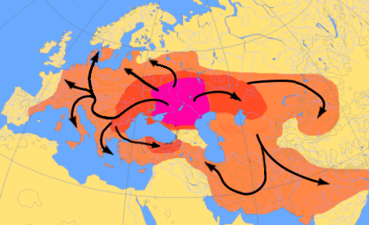
The spread of Indo-European and palaeogenetics
Illustration: D. Bachmann 2005
Illustration: Narashiman et al. 2019
Genetic data:
supports pre-existing linguistic theories
sheds light into black-box areas
aDNA anchors populations in time and space
better approximation for language groups

Slide 10
Scientific principles and outline
Underpinning principles:
Occam’s Razor
Uniformitarian Principle
Proposals need to be falsifiable
The Uniformitarian Principle:
“Unless we can demonstrate a relevant alteration in the conditions of language use or language acquisition between some time in the past and the present, we must assume that the same types of, range, and distribution of language structures existed and the same types of lin-guistic change processes operated at that past time as in the present.”
(D. Ringe & J. Eska, Historical Linguistics, 2013: 3–4, 30)
Focus:
Early Bronze Age, Britain and Ireland (c. 2450–2000 b.c.)
Late Bronze Age, Britain and Ireland (c. 1200–800 b.c.)
Iron Age, Ireland (first half 1st millennium a.d.)

Slide 11
I. The Early Bronze Age
Britain and Ireland 2450-2000 b.c.

Slide 12
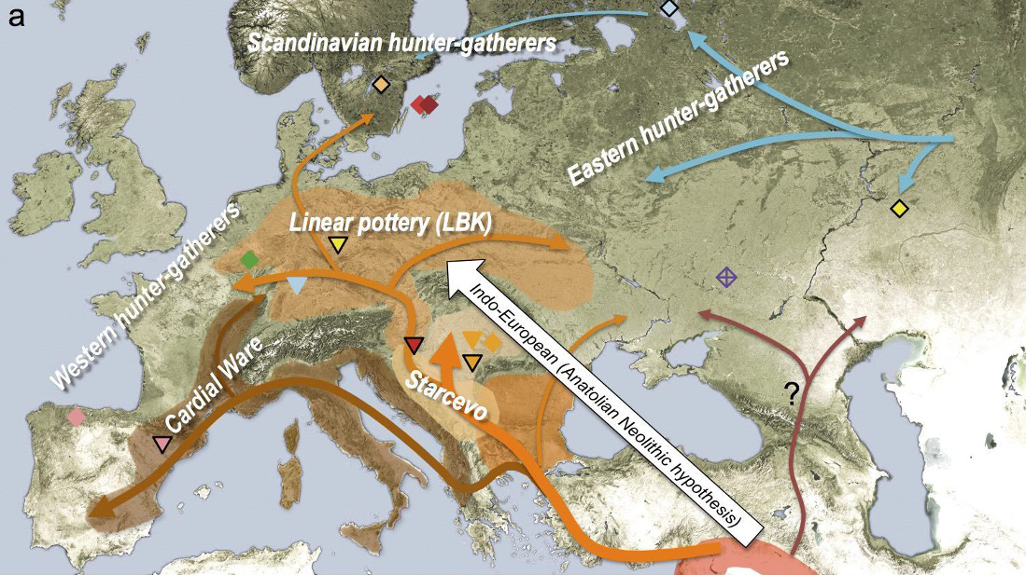
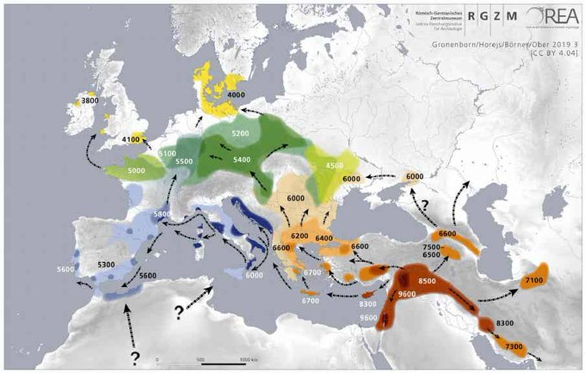
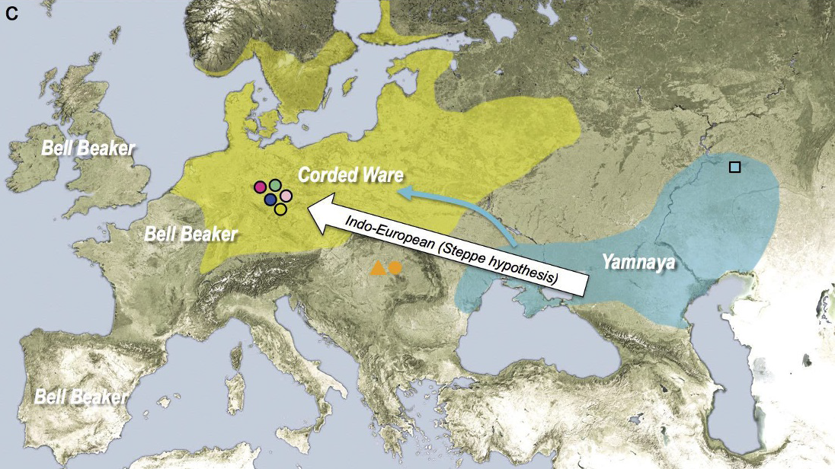
I. Early Bronze Age: Genetics
Eastern
Hunter-Gatherers
Western Hunter-Gatherers
Early European Farmers
Illustration: RGZM 2019
Prehistoric genetic (and linguistic?) groups:
Western Hunter-Gatherers (WHG)
Eastern Hunter-Gatherers (EHG;  IE?)
Early European Farmers (EEF; ‘Avidic’)
Steppe ancestry (IE)
Steppe Ancestry
Illustrations: Haak et al. 2015: 217

Slide 13
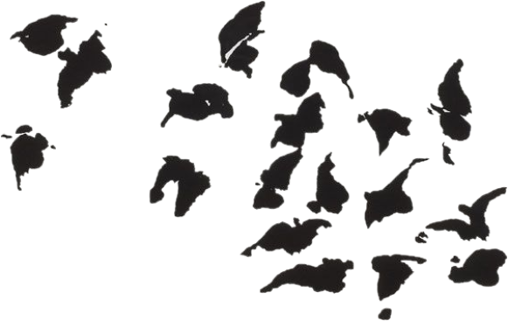
I. Early Bronze Age: Neolithic Early European Farmers
The language of the Early European Farmers:
numerous loans into European languages
Schrijver 1997: formal criteria for identifying loans
bird names, agricultural products
a-prefix with ablaut-like behaviour
referred to as:
‘language of the bird names’ (Schrijver 2001)
‘Avidic’ (Stifter 2010)
‘a-prefix language’
Schrijver 2018: related with Hattic, Minoan and Sumerian?
Kroonen et al. 2017-: agricultural terminology
Birds
The Táin. A flock of birds, Louis le Brocquy (1969)

Slide 14
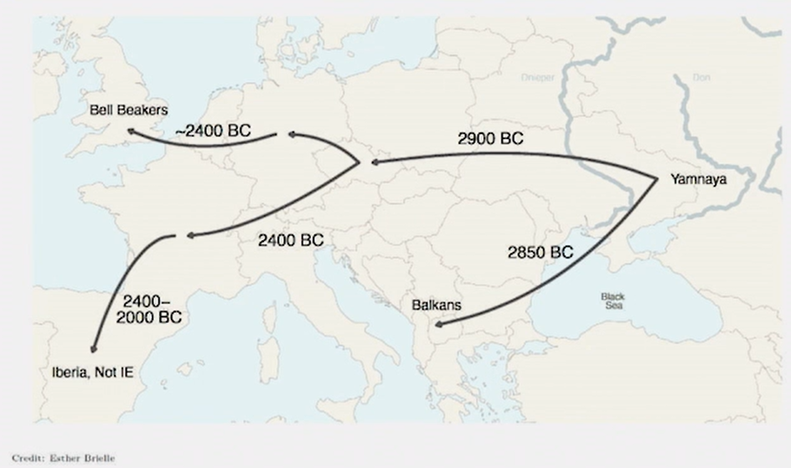
I. Early Bronze Age: Britain & Ireland
 | Greek | Lat. | Celt. | Germ.
*mesVl- ‘blackbird’ |  | *mesVl- > merula | *mesal(s)k- > W mwyalch | *a-msl- > OHG amsala
*rap- ‘turnip’ | *rapʰ- > rháphus, rháphanos | *rāp- > rāpum | *a-rp- >> *arb- > W erfin | *rāp- > *rōb- OHG ruoba
*mab- ‘raspberry’ |  |  | *mab-/*a-mb- > W mafon, MFr. ampe
*lisk-, *lVsk- ‘sedge, iris’ |  | *lisk- > ML. lisca | *a-lis(k)tro- > OIr. ailestar, W elestr | *leu̯sk- > MHG liesche
*raud- ‘ore’ |  | *raud- > raudus |  | *a-rud- > PG *arut-
*tæu̯r- ‘bull’ (?) | *tau̯̯r- > taũros | *tau̯̯r- > taurus | *taru̯̯- > OIr. tarb | *teu̯̯r- > PG *þeura-
Illustration: Patterson 2022
Examples of prehistoric, possibly Avidic loans (Kroonen 2024)

Slide 15
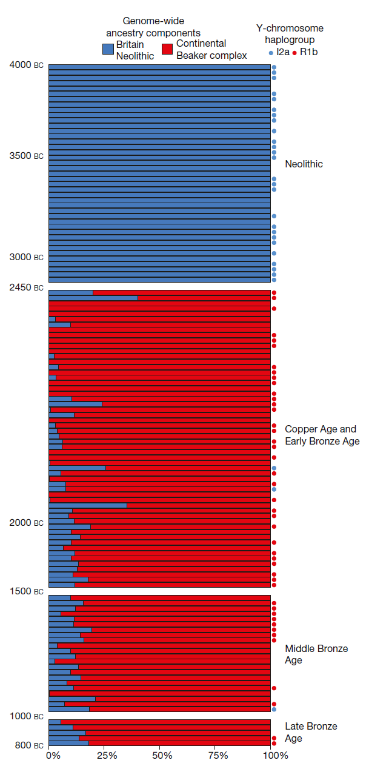
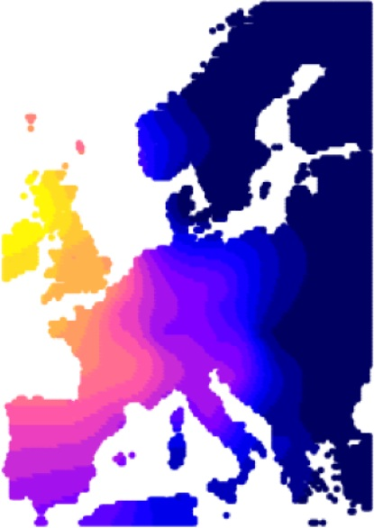
I. Early Bronze Age: Britain & Ireland
Illustration:
Olalde et al. 2018: 193
Illustration: Patterson 2022
Illustration: McColl et al. 2025

Slide 16
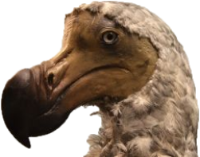
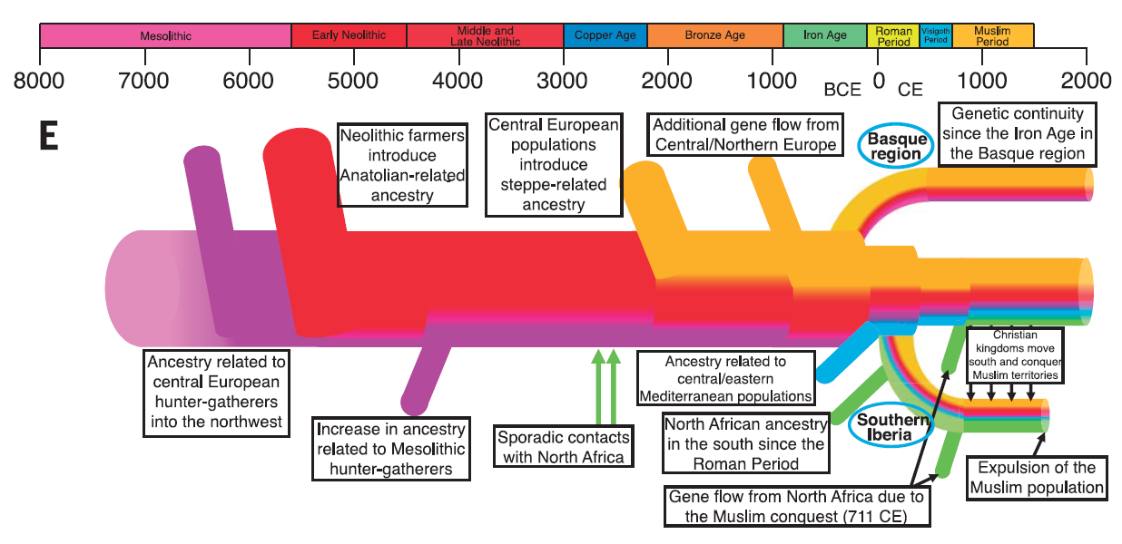
I. Early Bronze Age: Genetic fallout 1
Hamito-Semtic a.k.a. Afro-Asiatic Substratum Hypothesis:
syntactic peculiarities of Insular Celtic are due to substratum effect of Hamito-Semitic-type predecessor language, e.g.
J. Pokorny 1920s...
H. Wagner 1959
O. Gensler 1993
G. Broderick 2013
methodological critique, e.g.
St. Hewitt 2007
G. Isaac 2007
no specific genetic link with Western Archipelago
Moorjani et al. 2011
Cerezo et al. 2012
Botigué et al. 2013
A geinéolchu,
nom·aithbéoaigid!
Illustration: Olalde et al. 2019: 1232

Slide 17
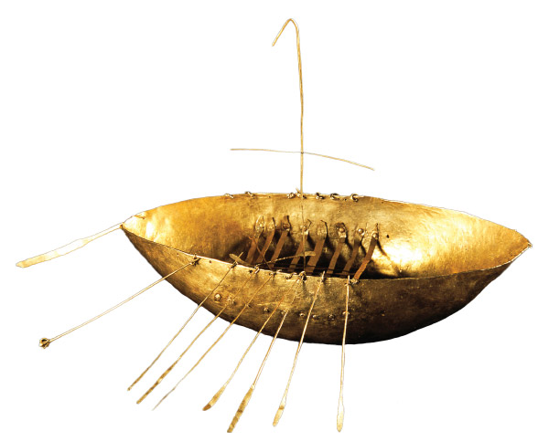
I. Early Bronze Age: Genetic fallout 2
‘Celtic from the West’ Hypothesis:
IE reached Atlantic zone c. 5000 b.c. with Neolithic revo-lution, Celtic arose c. 3000 b.c. as lingua franca along Atlantic seaboard, then spread eastward
J.T. Koch & B. Cunliffe 2010, 2013, 2016, 2019...
methodological critique, e.g.
G. Isaac 2004
J. Eska 2013, 2014
P. Sims-Williams 2020
genetic counterarguments
H. McColl et al. 2025
genetic links along Atlantic littoral?
Illustration: Broighter boat, © National Museum of Ireland

Slide 18
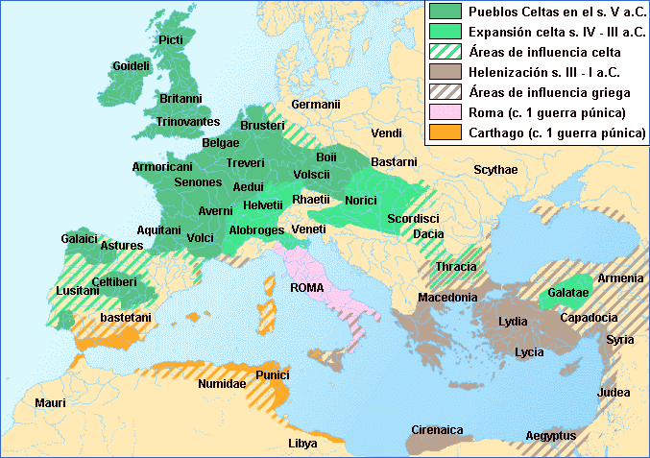
I. Early Bronze Age: Early Bronze Age Celts?
EBA Britain & Ireland:
L. Cassidy et al. 2016: 371: “…some level of local continuity at the edge of Europe persisting over 4,000 y.”
L. Cassidy et al. 2016: 368: “This turnover invites the possibility of accompanying introduction of Indo-European, perhaps early Celtic, language.”
Illustration: Instituto Geográfico Nacional

Slide 19
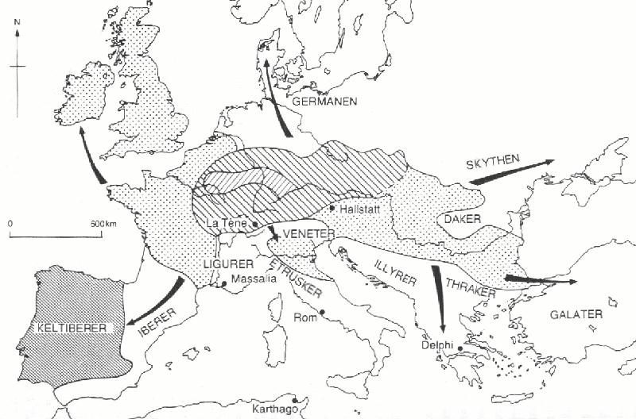
I. Early Bronze Age: Early Bronze Age Celts?
Early Bronze Age (EBA) Celts in Britain & Ireland?
pro:
EBA/Bell-Beaker influx seems to be last big immigra-tion genetically and archaeologically
contra:
similarity of Iron Age Celtic languages (e.g. Mallory 2013a: 261-262; 2013b: 28-30)
shallow time-depth of Proto-Celtic (late 2nd mill. b.c.)
loan relations with Proto-Germanic (Van Sluis, Jørgensen, Kroonen 2023)
connection with Italic (Sims-Williams 2020)
landlocked speech community (Stifter 2023)
Carpathian Basin (McColl et al. 2025)
?
?
EBA language in Western Archipelago = a lost IE branch? Indogermania Submersa?
‘Bell-Beakerish’

Slide 20
I. Early Bronze Age: ABC-hypothesis
Summary for Western Archipelago:
before 4th mill. b.c.: Western Hunter-Gatherers
4th-3rd mill. b.c.: Avidic-speaking Neolithic farmers
2450-2000 b.c.: IE Bell-Beakers with steppe an­cestry
 large-scale genetic displacement + linguistic replace- ment of Avidic by Bell-Beakerish
when oh when?: Celtic languages
 linguistic replacement of Bell-Beakerish by Celtic
Avidic  Bell-Beakerish  Celtic = ‘ABC-hypothesis’
The coming of the Celts
The Táin. Chariots, Louis le Brocquy (1969)
Corollaries:
IE etymologies for pre-Celtic substratal loans in Insular Celtic? (e.g., p-language and f-language loans in Irish)
amount of difference between Bell-Beakerish and Celtic?

Slide 21
I. Early Bronze Age: Questions for future research
Early Bronze Age:
• Can the Bell-Beakers be the carriers of a language that is the direct ancestor of Celtic? (unlikely IMHO, but what sound linguistic arguments do we have for this negative attitude?)
• What are the layers of pre-Celtic loanwords in Celtic, and can we distinguish between Continental (i.e. Western Indo-European), Insular and British vs. Irish layers?
• What layers of pre-Celtic toponyms are there on the Western Archipelago and in Western Europe?
• What are the sources for Bell-Beakerish (toponyms, loanwords in Celtic and other branches of IE)?
• What can we recover of ‘Bell-Beakerish’ and can it be shown to be a separate branch of Indo-European?
• How different was Bell-Beakerish from other Western Indo-European languages? How does it relate to other submerged branches of Indo-European (North-West Block, Old European)?

Slide 22
II. The Late Bronze Age
Britain 1200-800 b.c.

Slide 23
II. Late Bronze Age: Continental influx into Britain
A Late Bronze Age vector for Celtic?
N. Patterson et al. 2022:
influx of genes from France into southern Britain 1200-800 b.c.
L. Cassidy et al. 2025:
exchange of southern Britain with France 1000-875 b.c.
‘insularity’ of northern Britain, esp. Scot-land
H. McColl et al. 2025:
Middle Bronze Age link with southern France and Iberia
Late Bronze Age/Early Iron Age influx from central eastern Europe
R. McLaughlin (ongoing research)
focal areas of activity in southern Britain
Illustration: N. Patterson 2022

Slide 24
II. Late Bronze Age: Continental influx into Britain
A Late Bronze Age vector for Celtic?
chronologically most promising and fitting
geographically linked with eastern central Europe
= break-up of Proto-Celtic linguistic unity? but not end of intra-Celtic contacts
later spread of innovations, e.g. *isarno- ‘iron’, *karbanto- ‘chariot’, etc.
Common Celtic pantheon, e.g. *Lugus, *Brigantī, *Gobann(ii̯)ū, *Ogmii̯os, *Ai̯sus/Ai̯̯su̯ii̯ā?
higher admixture of EEF genome than Bell-Beakers
is language contact cause of Celtic peculiarities?
Illustration: N. Patterson 2022
And Ireland…?
not much data… yet
but rise of hillforts in LBA (cf. J. Mallory 2016 & W. O’Brien 2016)
population decline after 800 b.c.

Slide 25
II. Late Bronze Age: Questions for future research
Late Bronze Age/Early Iron Age:
• What evidence is there for LBA/EIA contacts with other languages (Iberian? Aquitanian? others?) and for Celtic expansion to the west?
• What is the evidence for an Iron-Age (i.e. post-Proto-Celtic) pan-Celtic continuity or cross-Celtic linguistic contact (technological innovation? E.g., *isarno- ‘iron’ *karbanto- ‘chariot’, etc.
pan-Celtic divinities: *Brigantī *Lugus *Gobann(ii̯)ū *Ogmii̯os *Ai̯sus/*Ai̯su̯ii̯ā (?)

Slide 26
III. The Late Iron Age
Ireland mid-1st millennium a.d.

Slide 27
III. Late Iron Age: Why is Old Irish so uniform?
The homogeneity of Old Irish
extant OIr. sources (7th-9th c.) seem to reflect a uniform language without dialectal variation
Explanatory strategies:
one variety from a spectrum elevated to learned standard
the language actually lacks diatopic variation
Additional aspects:
OIr. is not uniform:
300+ types of synchronic variation
variation cannot be mapped diatopically
inadequate methodology?
all later Gaelic varieties continue directly OIr.
Way forward:
more research with adequate methodology
Advanced Laureate Award DiⒶgnostic (2023-7)

Slide 28
III. Late Iron Age: Why is Old Irish so uniform?
The homogeneity of Old Irish
extant OIr. sources (7th-9th c.) seem to reflect a uniform language without dialectal variation
Explanatory strategies:
one variety from a spectrum elevated to learned standard
the language actually lacks diatopic variation  abnormal situation!
Additional aspects:
OIr. is not uniform:
300+ types of synchronic variation
variation cannot be mapped diatopically
inadequate methodology?
all later Gaelic varieties continue directly OIr.
Data to be utilised:
archaeology
palaeoclimatology
palaeogenetics
‘linguistic archaeology’
Way forward:
more research with adequate methodology
Advanced Laureate Award DiⒶgnostic (2023-7)

Slide 29
III. Late Iron Age: Homogenisation of Irish?
A model for the homogenisation of Irish
Great Upheaval of the Phonological System (GUPS) in 5th-6th c. a.d. caused by rapid language shift?
pre-Celtic surviving in Ireland in 5th c. a.d. (Schrijver 2000, 2005)
‘p-language’ (one of several recognisable substratal layers in Irish)
substratal layers | examples
Avidic | see above
2.a geminates | *girūdd- ‘periwinkle’, *gaddā- ‘theft’, *slattā- ‘rod’, *ātti- ‘place’,…
2.b *-sk- | áesc ‘shell’, blóesc, W blisg ‘husk, shell’, blesc ‘harlot < *she-wolf’, W mwyalch < *mesal(s)kā- ‘blackbird’,…
3a. *p-, *-pp- | *part- ‘crab’, *pettā- ‘pet’, *pattū- ‘hare’, *parn- ‘whale’, *pullo- ‘hole’, *kappilo- ‘horse’, *lupp(antī)- ‘young pig’,…
3b. *-su̯- > -f- | bréife ‘ring’, cufar ‘leg’, cuifre/cuipre ‘indulgence’, fafall ‘filth’, lufe ‘female’, slife ‘broadening’; place names Aífe (?), Bréifne, Crufait, Dún Gaifi, Faffand, Grafand/Rafann/ Raphe, Grafrenn, Life, Máfat
Sources: Schrijver 2000; Mac Eoin 2007; Stifter 2023a, 2023b, 2024
Notes: 2 = Insular Celtic; 3 = Goidelic

Slide 30
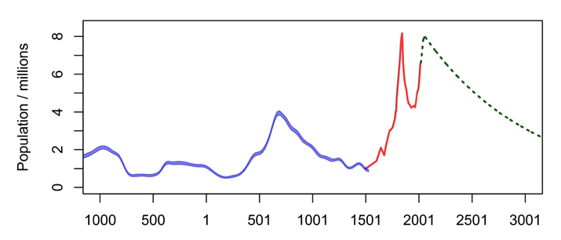
III. Late Iron Age: Homogenisation of Irish?
A model for the homogenisation of Irish
Great Upheaval of the Phonological System (GUPS) in 5th-6th c. a.d. caused by rapid language shift?
pre-Celtic surviving in Ireland in 5th c. a.d. (Schrijver 2000, 2005)
external factors:
mid-6th century famine (536)
and epidemics (549, 554, 556)
internal unrest and mobility
linguistic leveling
Graph: R. McLaughlin, Emania 2020: 24
early medieval spike
death of pre-Celtic language?
‘Late Iron
Age lull’
mid-6th cent. plateau climate disaster, epidemic
early modern spike
death of the Irish language

Slide 31
III. Late Iron Age: Questions for future research
Late Iron Age/Early Middle Ages:
• What is the pre-Roman and early Roman linguistic situation in Gaul?
• How long did pre-Celtic languages survive in Ireland? And in Britain?
• Is Old Irish a homogenous, dialectally not differentiated language or were there regionally diversified dialects in Old Irish (6th century onwards)?
• Was there diastratic variation, i.e. different social registers of speech in Old Irish?
• If Old Irish was homogenous, how can this unusual situation be explained?
• What is the relationship of Old Irish/Gaelic in Ireland and in Scotland? When did the two varieties separate from each other and what is the direction of separation?

Slide 32
References
Allentoft, Morten E. et al. 2015. ‘Population genomics of Bronze Age Eurasia’, Nature 522, 167–172.
Anthony, David W. and Don Ringe 2015. ‘The Indo-European Homeland from Linguistic and Archaeological Perspectives’, Annual Review of Linguistics 1, 199–219. https://www.annualreviews.org/doi/abs/10.1146/annurev-linguist-030514-124812
Anthony, David W. 2020. ‘Ancient DNA, Mating Networks, and the Anatolian Split’, in: Matilde Serangeli and Thomas Olander (eds.), Dispersals and Di-versification. Linguistic and Archaeological Perspectives on the Early Stages of Indo-European [= Brill’s Studies in Indo-European Languages & Linguistics 19], Leiden: Brill, 21–53.
Botigué, L. R. et al. 2013. ‘Gene flow from North Africa contributes to differential human genetic diversity in southern Europe’. Proc. Natl Acad. Sci. USA 110, 11791–11796
Broderick, George 2013. ‘Indo-European and non Indo-European aspects to the languages and place-names in Britain and Ireland: an overview’, in: Cathinka Hambro og Lars Ivar Widerøe (eds.), Lochlann. Festskrift til Jan Erik Rekdal på 60-årsdagen. Aistí in ómós do Jan Erik Rekdal ar a 60ú lá breithe. Oslo: Hermes, 282–314.
Cerezo, M. et al. 2012. ‘Reconstructing ancient mitochondrial DNA links between Africa and Europe’. Genome Res. 22, 821–826.
Cassidy, Lara M. et al. 2016. ‘Neolithic and Bronze Age migration to Ireland and estab­lish­ment of the insular Atlantic genome’, Proceedings of the National Academy of Sciences of the United States 113/2, 368–373.
Cassidy, Lara M. et al. 2025. ‘Continental influx and pervasive matrilocality in Iron Age Britain’, Nature 15 Jan 2025. https://doi.org/10.1038/s41586-024-08409-6
Chintalapati, Manjusha, Nick Patterson, Priya Moorjani 2022. ‘Reconstructing the spatiotemporal patterns of admixture during the European Holocene using a novel genomic dating method’, https://www.biorxiv.org/content/10.1101/2022.01.18.476710v1
Cunliffe, Barry and John T. Koch (eds.) (2010). Celtic from the West. Alternative Perspectives from Archaeology, Genetics, Language, and Literature [= Celtic Studies Publica­tions 19]. Oxford: Oxbow Books.
Cunliffe, Barry and John T. Koch (eds.) 2013. Celtic From the West 2. Rethinking the Bronze Age and the Arrival of Indo–European in Atlantic Europe. Oxford: Oxbow Books.
Cunliffe, Barry and John T. Koch (eds.) (2016). Celtic from the West 3. Atlantic Europe in the Metal Ages: Questions of Shared Language [= Celtic Studies Publica­tions 19]. Oxford: Oxbow Books.
Cunliffe, Barry and John T. Koch (eds.) 2019. Exploring Celtic Origins: New Ways Forward in Archaeology, Linguistics, and Genetics [= Celtic Studies Publications 22]. Oxford – Philadelphia: Oxbow Books.
Drews, Robert 2022. ‘The Kelticizing of Western Europe, Britain, and Ireland’, Journal of Indo-European Studies 50/3–4, 307–333.

Slide 33
References
Dulias, Katharina et al. 2022. ‘Ancient DNA at the edge of the world: Continental im-migration and the persistence of Neolithic male lineages in Bronze Age Orkney’, Proceedings of the National Academy of Sciences of the United States 119/8. doi: https://doi.org/10.1073/pnas.2108001119
Eska, Joseph F. 2013. Review of John T. Koch, Tartessian & Tartessian 2, in: Kratylos 58, 58–73.
Eska, Joseph F. 2014. ‘Comments on John T. Koch’s Tartessian-as-Celtic enterprise’, Journal of Indo-European Studies 42/3–4, 428–438.
Gensler, Orin 1993. A Typological Evaluation of Celtic/Hamito-Semitic Syntactic Parallels, PhD-thesis, University of Berkeley. URL: https://escholarship.org/uc/item/8p00g5sd
Haak, Wolfgang et al. 2015. ‘Massive migration from the steppe was a source for Indo-European languages in Europe’, Nature 522, 207–211.
Heggarty, Paul et al. 2023. ‘Language trees with sampled ancestors support a hybrid model for the origin of Indo-European languages’, Science 381, issue 6656 (23 July 2023). doi: https://doi.org/10.1126/science.abg0818
Hewitt, Steve 2007. ‘Remarks on the Insular Celtic/Hamito-Semitic question’, in: Raimund Karl, David Stifter (eds.), The Celtic World. Critical Concepts in Historical Studies. Volume IV. Celtic Linguistics. London – New York: Routledge, 230–286.
Isaac, Graham 2004. ‘The Nature and Origins of the Celtic Languages: Atlantic Seaways, Italo-Celtic and Other Paralinguistic Misapprehensions’, Studia Celtica 38, 49–58.
Isaac, Graham 2007. ‘Celtic and Afro-Asiatic’, in: Hildegard L.C. Tristram (ed.), The Celtic Languages in Contact. Papers from the Workshop within the Framework of the XIII Inter­na­tional Congress of Celtic Studies, Bonn, 26–27 July 2007. Potsdam University Press, 25–80.
Kristiansen, Kristian, Guus Kroonen, and Eske Willerslev (eds.) 2023. The Indo-European Puzzle Revisited. Integrating Archaeology, Genetics, and Linguis-tics. Cambridge University Press.
Kroonen, Guus (ed.) 2024. Sub-Indo-European Europe: Problems, Methods, Results. Berlin: Mouton de Gruyter.
Kroonen, Guus 2024. ‘A methodological introduction to sub-Indo-European Europe’, in: Guus Kroonen (ed.), Sub-Indo-European Europe: Problems, Methods, Results. Berlin: Mouton de Gruyter, 3–26.
Lazaridis, Iosif et al. 2013. ‘Ancient human genomes suggest three ancestral populations for present-day Europeans’, Nature 513, 409–413.
Mallory, James P. 2013. The Origins of the Irish. London – New York: Thames & Hudson.
Mallory, James P. 2013b. ‘The Indo-Europeanization of Atlantic Europe’, in: John T. Koch, Barry Cunliffe (eds.), Celtic From the West 2. Rethinking the Bronze Age and the Arrival of Indo-European in Atlantic Europe, Oxford: Oxbow Books, 17–40.
Mallory, James P. 2016. ‘Archaeology and Language Shift in Atlantic Europe’, in: John T. Koch, Barry Cunliffe (eds.), Celtic from the West 3. Atlantic Europe in the Metal Ages. Questions of Shared Language, Oxford: Oxbow Books, 387–406.
Mallory, James 2023. ‘From the steppe to Ireland: The impact of aDNA research’, in: Kristian Kristiansen, Guus Kroonen, and Eske Willerslev (eds.) 2023. The Indo-European Puzzle Revisited. Integrating Archaeology, Genetics, and Linguistics. Cambridge University Press, 129–145.

Slide 34
References
McColl, Hugh, Eske Willerslev, Guus Kroonen et al. 2025. ‘Tracing the spread of Celtic languages using ancient genomics’, bioRxiv prepint 1 March 2025. doi: https://doi.org/10.1101/2025.02.28.640770
McLaughlin, T. Rowan 2020. ‘An Archaeology of Ireland for the Information Age’, Emania 25, 7–29.
Moorjani, P. et al. 2011. ‘The history of African gene flow into southern Europeans, Levantines, and Jews’. PLoS Genet. 7, e1001373.
O’Brien, William 2016. ‘Language Shift and Political Context in Bronze Age Ireland: some inplications of hillfort chronology, in: John T. Koch, Barry Cunliffe (eds.), Celtic from the West 3. Atlantic Europe in the Metal Ages. Questions of Shared Language, Oxford: Oxbow Books, 219–246.
Olalde, Iñigo et al. 2018. ‘The Beaker phenomenon and the genomic transformation of northwest Europe’, Nature 555, 190–196.
Olalde, Iñigo et al. 2019. ‘The genomic history of the Iberian Peninsula over the past 8000 years’, Science 363, 1230–1234.
Patterson, Nick et al. 2022. ‘Large-scale migration into Britain during the Middle to Late Bronze Age’, Nature 601, 588–594.
Schrijver, Peter 1997. ‘Animal, vegetable and mineral: some Western European substratum words’, in: Alexander Lubotsky (ed.), Sound Law and Analogy. Papers in Honor of Robert S. P. Beekes on the occasion of his 60th birthday. Amsterdam: Rodopi, 293–316.
Schrijver, Peter 2000. ‘Varia V. Non-Indo-European surviving in Ireland in the first millenium a.d.’, Ériu 51, 195–199.
Schrijver, Peter 2005. ‘Varia I. More on non-Indo-European surviving in Ireland in the first millen­nium a.d.’, Ériu 55, 137–144.
Schrijver, Peter 2014. Language Contact and the Origins of the Germanic Languages [= Routledge Studies in Linguistics 13]. New York – London: Rout-ledge.
Schrijver, Peter 2018. ‘Talking Neolithic: The Case for Hatto-Minoan and its Relationship to Sumerian’, in: Guus Kroonen, James P. Mallory and Bernard Comrie (eds.), Talking Neo­lithic: Proceedings of the workshop on Indo-European origins held at the Max Planck Institute for Evolutionary Anthropology, Leipzig, December 2–3, 2013 [= JIES Monograph 65]. Washington, DC: Institute for the Study of Man, 336–374.
Sims-Williams, Patrick 2020. ‘An Alternative to ‘Celtic from the East’ and ‘Celtic from the West’, Cambridge Archaeological Journal 30/3, 511–529.
Stifter, David 2010. ‘The invisible third: the Basque and Celtic words for ‘swallow’’, Ériu 60, 145–157.
Stifter, David 2023. ‘With the back to the ocean. The Celtic maritime vocabulary’, in: Kris­tian Kristiansen, Guus Kroonen & Eske Willerslev (eds.), When Archaeology Meets Linguistics and Genetics. Towards a new European Prehistory. Cambridge University Press, 172-192.
Stifter, David 2024. ‘Prehistoric layers of loanwords in Old Irish’, in: Guus Kroonen (ed.), Sub-Indo-European Europe. Problems, Methods, Results. Berlin: Mouton de Gruyter, 157–202.
Van Sluis, Paulus, Anders Richardt Jørgensen, Guus Kroonen 2023. ‘European Prehistory between Celtic and Germanic: the Celto-Germanic isoglosses revisited’, in: Kristian Kristiansen, Guus Kroonen, and Eske Willerslev (eds.) 2023. The Indo-European Puzzle Revisited. Integrating Archaeology, Genetics, and Linguistics. Cambridge University Press, 193-242.
Wagner, Heinrich 1959. Das Verbum in den Sprachen der britischen Inseln. Ein Beitrag zur geographischen Typologie des Verbums [= Buchreihe der Zeitschrift für celtische Philologie 1], Tübingen: Niemeyer.

Slide 35
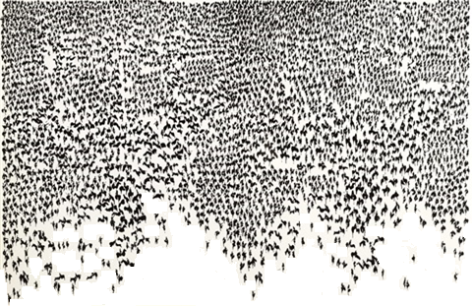
Ad·tlochur indithim dúib!
Thank you very much for your attention
Prof. David Stifter MRIA
Dept. of Early Irish
School of Celtic Studies
Maynooth University
david.stifter@mu.ie
@davidstifter.bsky.social
Population growth
The Táin. Army massing, Louis le Brocquy (1969)

